Slide 1
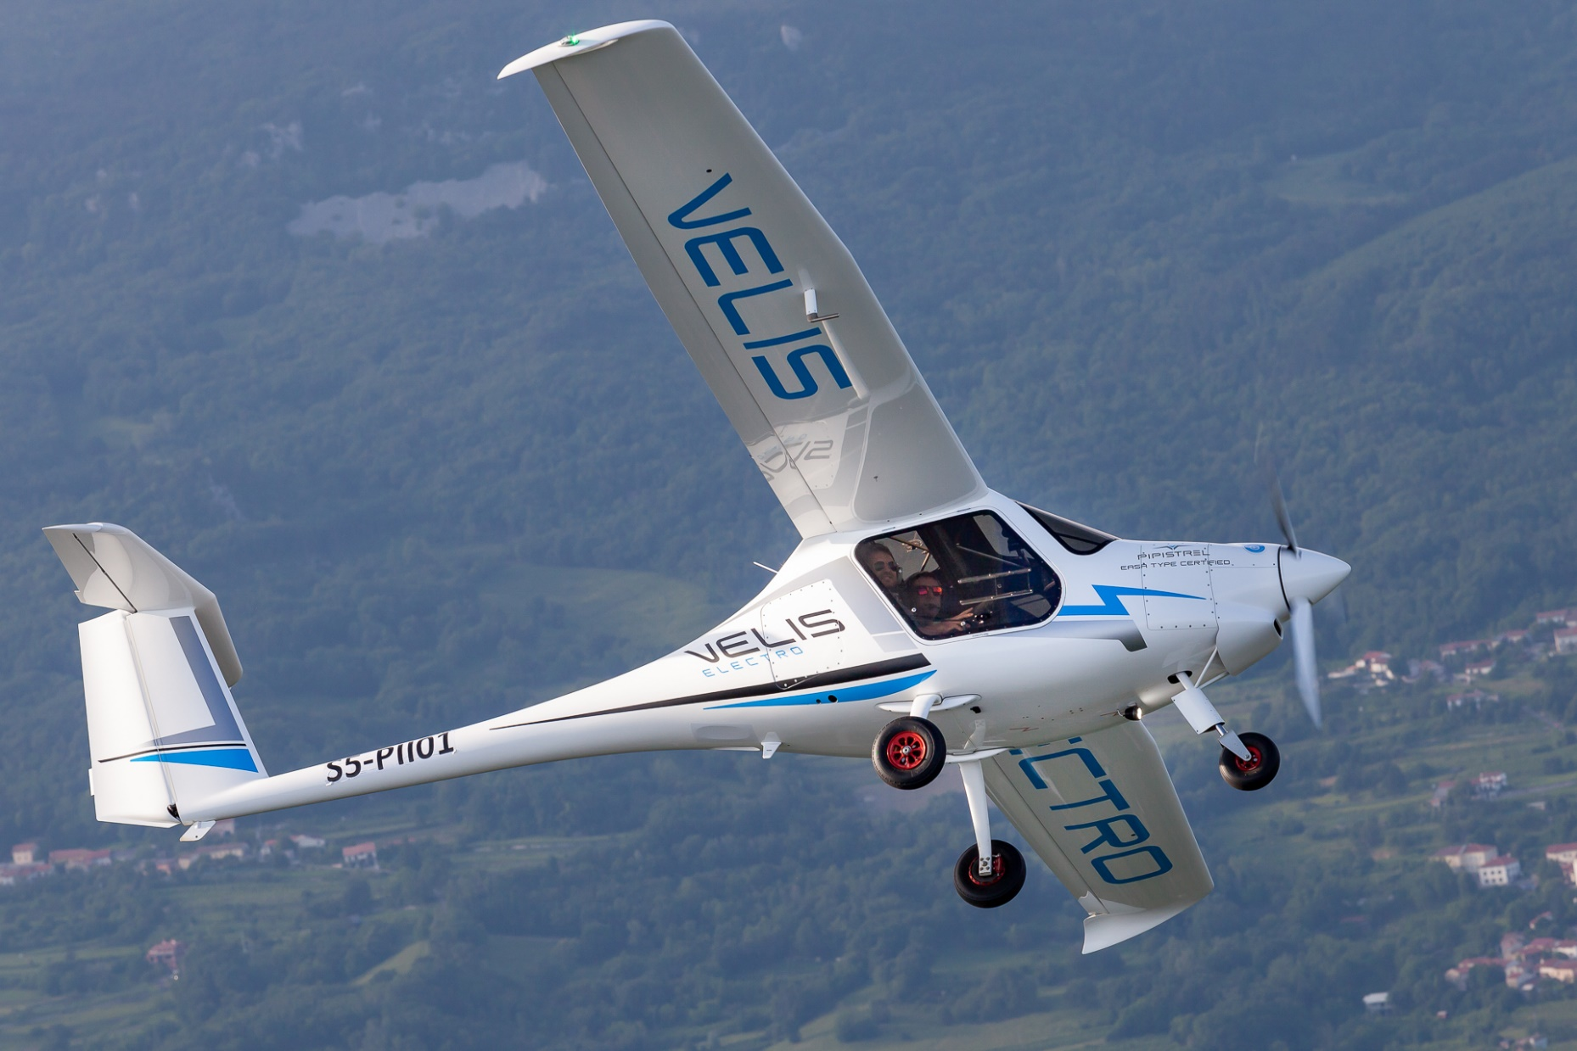
Take0ff Power And Energy Performance
Nathan Lu
Management Engineering

Slide 2
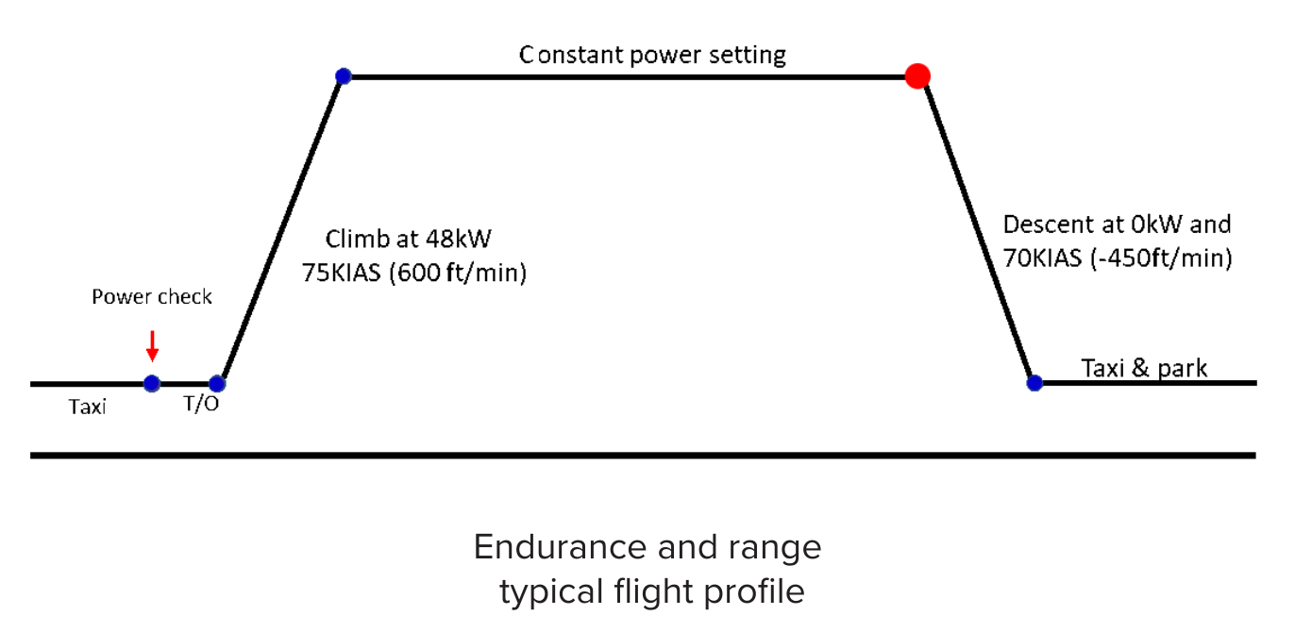
Questions Addressed
How do various power settings affect the climb rate?
  We want the lowest change of increased time to reach altitude per drop in power (kW).
Any experimental difference between standing and rolling takeoff?
  Theoretical states a 1% difference.
How do other factors affect the performance?
  Weather.
  Battery State of Health.
How does the initial power setting affect the total takeoff power?

Slide 3
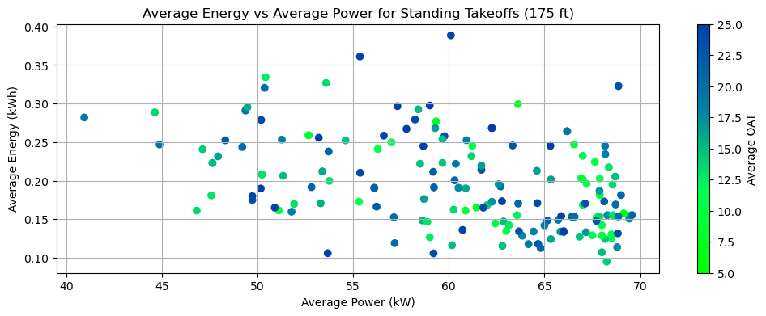
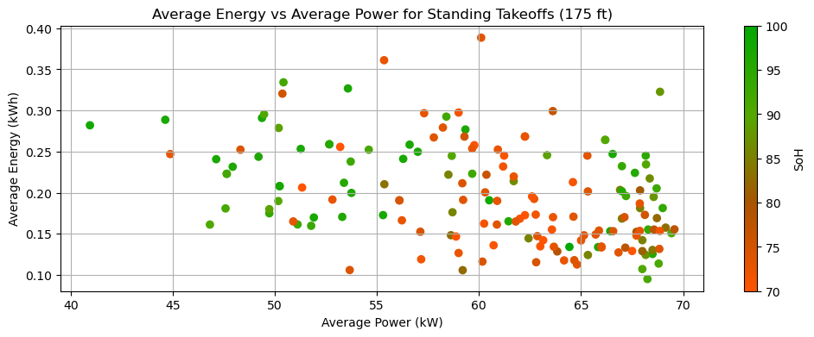
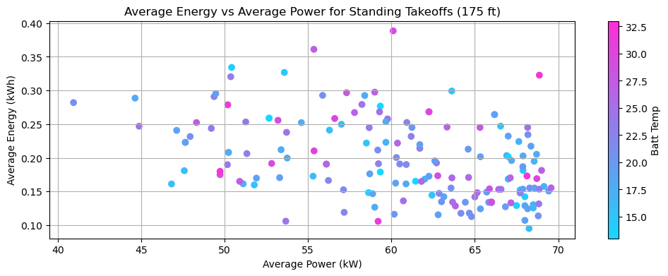
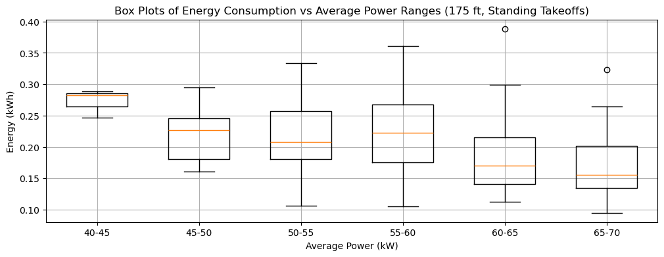
Standing Power Performance (175 ft)

Slide 4
Findings
    (Performance is in energy consumption as power decreases from 0-175 ft)
Moderately weak correlation for average energy consumption vs average power
  This seems to be the case with all energy data
  Points are more spread out and show a slight negative correlation
Low-Moderate correlation based on OAT
  Temperatures from 5-10°C had the worst performing flights while data from 10-25°C had similar performance
  Variance in Temperature has a negligible effect
Battery SoH had a low correlation on performance data
  Lower SoH values were more efficient in higher power settings and had more variance compared to higher SoH Values
Weak moderate correlation between battery temperature and energy
  Temperatures from 23-28°C had the greatest change of energy consumption (worst performer) but considered negligible

Slide 5
Findings
    (Performance is in energy consumption as power decreases from 0-175 ft)
The slope yielded a 0.0036 decrease in kWh per increase in kW
Comparison of a 45 kW average and a 65 kW power setting to reach 175 ft:
  0.072 kWh difference
  0.3% dSoC at 100% SoH
  0.375% dSoC at 80% SoH
0.075% decrease in SoC per 5
kW increase

Slide 6
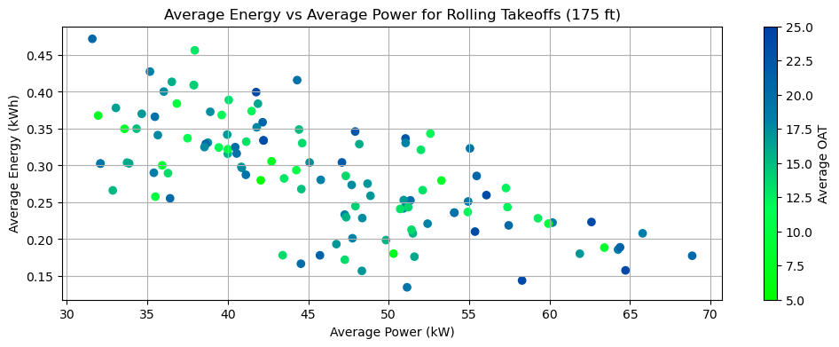
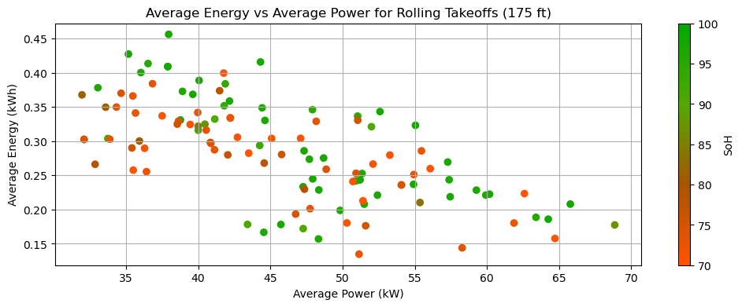
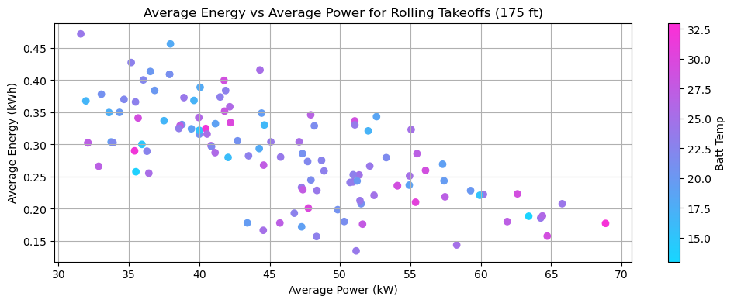
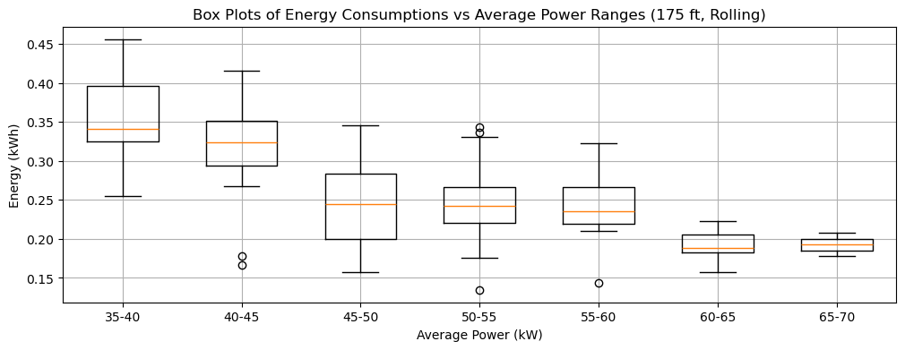
Rolling Power Performance (175 ft)

Slide 7
Findings
    (Performance is in energy consumption as power decreases from 0-175 ft)
Moderately strong correlation between energy consumption and rolling takeoff power averages
OAT Data has low variance when classified with different outside temperatures
  Deemed negligible as a significant factor
SoH data had a moderately strong correlation to energy consumption
  Lower SoH values typically yielded lower consumption rates compared to higher SoH of the same power setting
Battery temperatures had little to no influence on energy consumption

Slide 8

Findings
    (Performance is in energy consumption as power decreases from 0-175 ft)
The slope yielded a 0.0056 decrease in kWh per increase in kW
Comparison of a 45 kW average and a 65 kW power setting to reach 175 ft:
  0.112 kWh difference
  0.47% dSoC at 100% SoH
  0.58% dSoC at 80% SoH
0.12% decrease in SoC per 5 kW
increase

Slide 9
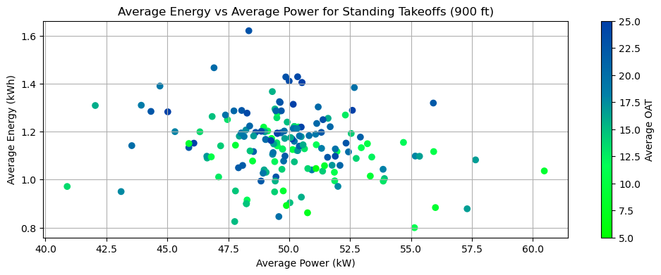
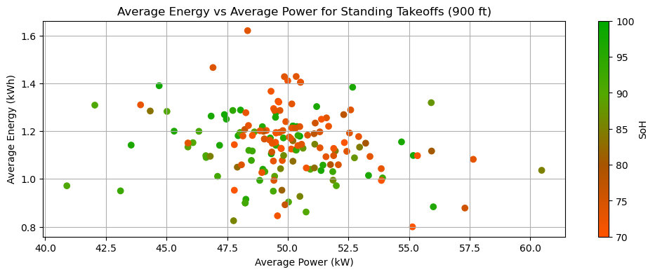
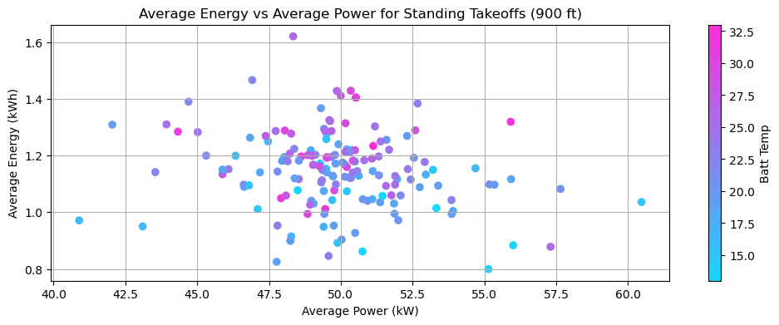
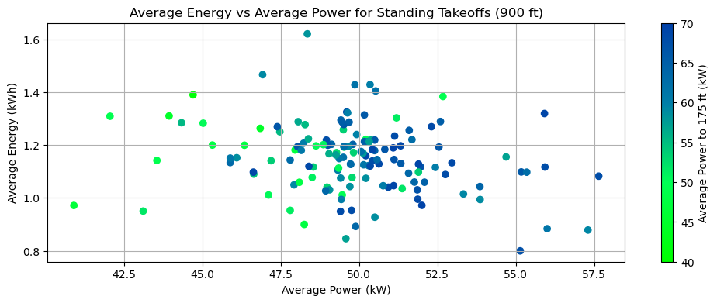
Standing Power Performance (900 ft)

Slide 10
Findings
    (Performance is in energy consumption as power decreases from 0-900 ft)
Average power settings is much more centralized when analyzed to 900 ft
OAT had a moderate correlation between energy consumptions with lower temperatures yielding less consumptions. This trend also follows the battery temperature as expected.
Surprisingly, flights with lower SoH (70-85) had higher energy consumption with around a 0.1 kWh difference. This behavior is the opposite compared to the initial flight stage (175 ft)
In standing takeoffs, higher initial power settings play a much more influential role in determining the total energy consumption from 0-900 ft

Slide 11
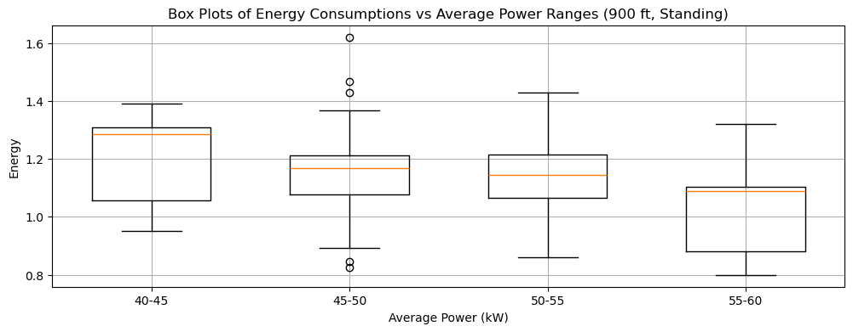
Findings
    (Performance is in energy consumption as power decreases from 0-900 ft)
The slope yielded a 0.008956 decrease in kWh per increase in kW
Comparison of a 45 kW average and a 65 kW power setting to reach 900 ft:
  0.18 kWh difference
  0.75% dSoC at 100% SoH
  0.94% dSoC at 80% SoH
0.2% decrease in SoC per 5 kW
increase

Slide 12
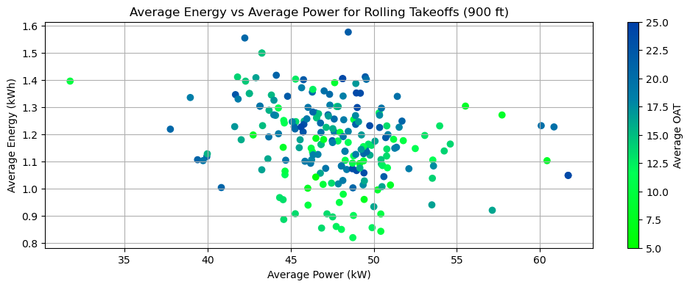
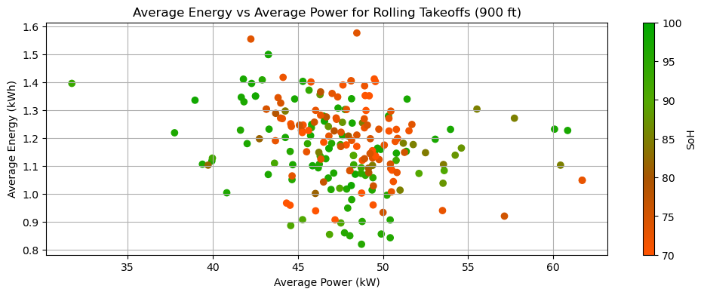
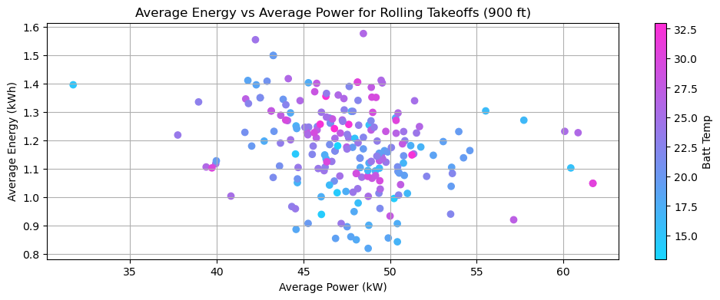
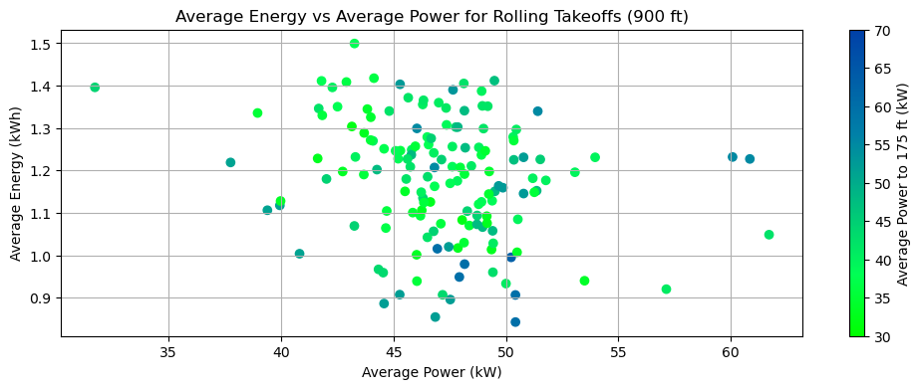
Rolling Power Performance (900 ft)

Slide 13
Findings
    (Performance is in energy consumption as power decreases from 0-900 ft)
Dataset is centralized compared to standing takeoffs
OAT plays a much more significant impact on energy consumption with colder average temperatures performing more efficient compared to higher temperatures. This can be also observed with the battery temperature.
SoH also has the same trend but is tighter compared to OAT
There are less data points with higher initial power settings due to high initial speed in rolling takeoffs
  However, flights with higher initial power settings were responsible for consuming significantly less energy compared to a lower initial power setting (many points under 0.9 kWh, 3.75% dSoC at 100% SoH)

Slide 14
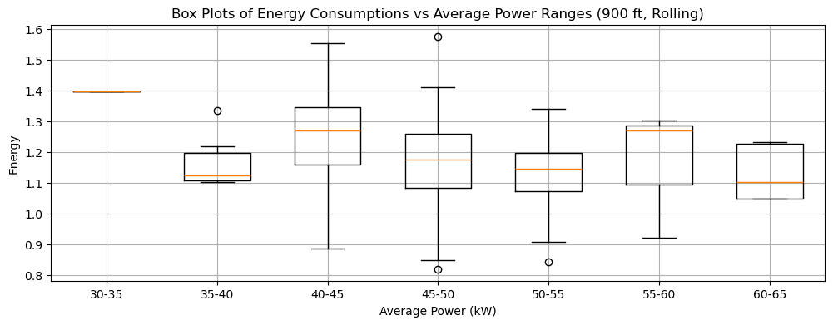
Findings
    (Performance is in energy consumption as power decreases from 0-900 ft)
The slope yielded a 0.008970 decrease in kWh per increase in kW
Comparison of a 45 kW average and a 65 kW power setting to reach 900 ft:
  0.18 kWh difference
  0.75% dSoC at 100% SoH
  0.94% dSoC at 80% SoH
0.2% decrease in SoC per 5 kW
increase

Slide 15
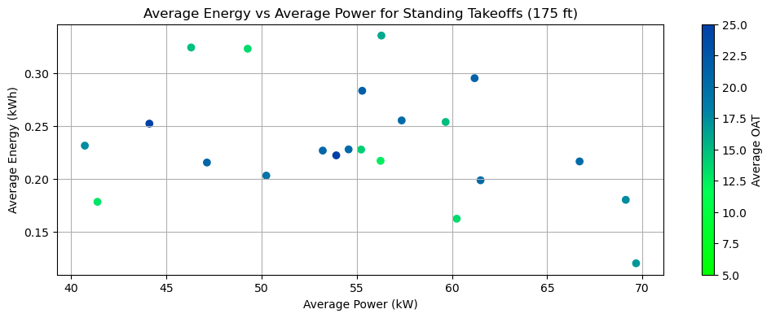
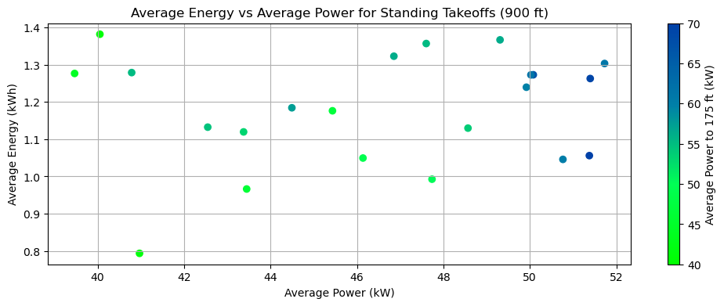
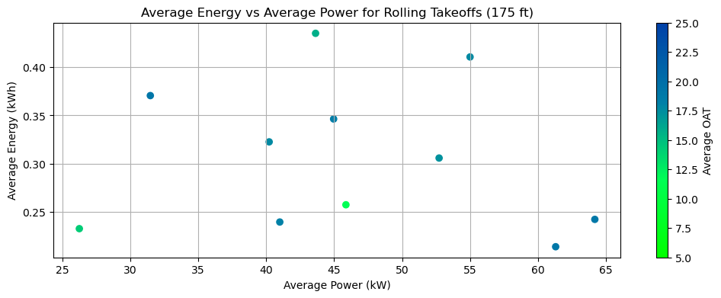
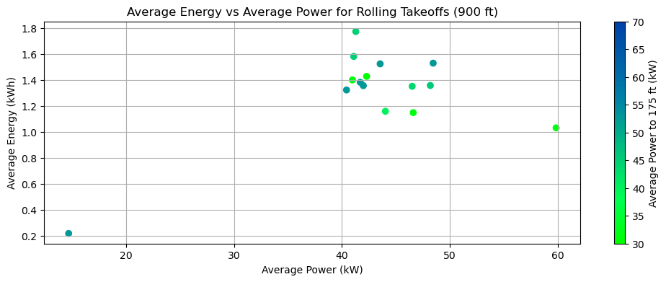
Derated Power Performance
    [Flights with intentional lower power settings (Vancouver & Derated UW Flights)]

Slide 16
Findings
    (Performance is in energy consumption as power decreases from 0-175 ft)
Data points are too scattered, need more flights for any conclusive results
Higher temperatures compared to Waterloo (Useful in analyzing high temperature influence)
Despite the variances in rolling takeoffs, energy consumption and average power usage centralizes at 900 ft.
  Initial power setting is insignificant
Results are as expected when compared to flights with similar power settings

Slide 17
Conclusions/Insights
Higher average power settings result in less total energy consumption, leading to more efficient takeoffs.
Initial power for standing flights have a greater influence on average power for the entire takeoff.
  Priority in power optimization
  45-50 kW had similar efficiency compared to 50-55 kW and 55-60 kW.
Expect to see less change in rolling takeoffs
  45-50 kW had similar efficiency compared to 50-55 kW and 55-60 kW as well.
Higher temperatures improved initial takeoff performance but reduced efficiency in the long run
  Higher temperatures can improve efficiency at lower altitudes due to better battery performance and reduced air density.
  When the power setting is decreased throughout the climb, would the continued lower air density render the climb less efficient?

